Slide 1
CS – 677 Term Project
Car Insurance Claim Classifier

Slide 2
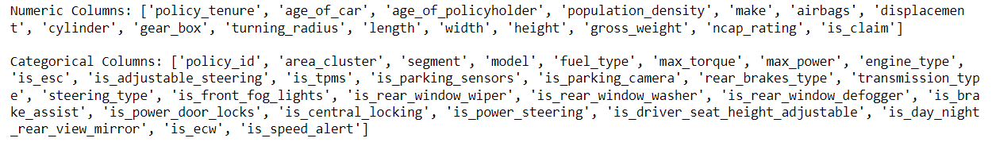
About The Project
This project aims to use machine learning models to predict whether someone with car insurance is likely to make a claim within the next 6 months by analyzing various factors about the policyholder.
Data:
The dataset has been taken from Kaggle. The Dataset contains information on policyholders having the attributes like policy tenure, age of the car, age of the car owner, the population density of the city, make and model of the car, power, engine type, etc., and the target variable indicating whether the policyholder files a claim in the next 6 months or not.
42 total features.
16 numeric, 26 categorical.

Slide 3
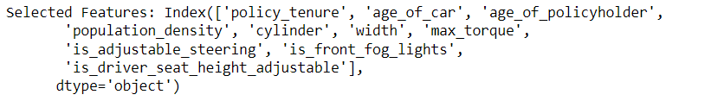
Feature Selection
I employed SelectKBest, a feature selection method from sk-learn, utilizing the f_classif statistical test.
The f_classif test calculates the ANOVA F-statistic for each feature independently. The ANOVA F-statistic helps assess whether the means of the feature values for different classes (claimed or not claimed) are significantly different. Higher F-statistic values indicate greater differences in means among classes, suggesting that the feature is relevant for distinguishing between the two classes.
This process helped me identify the top 10 most impactful features.
6 Numeric and 4 Categorical.

Slide 4
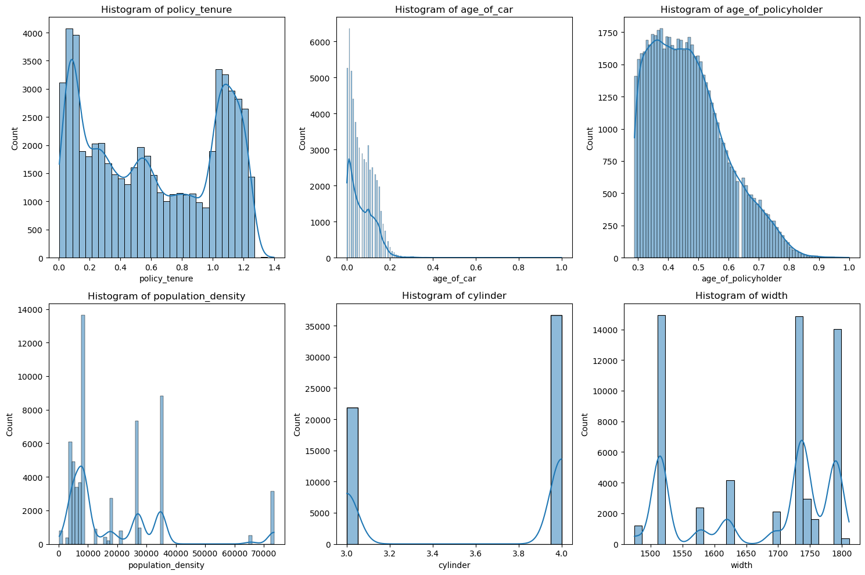
Exploratory Data Analysis

Slide 5
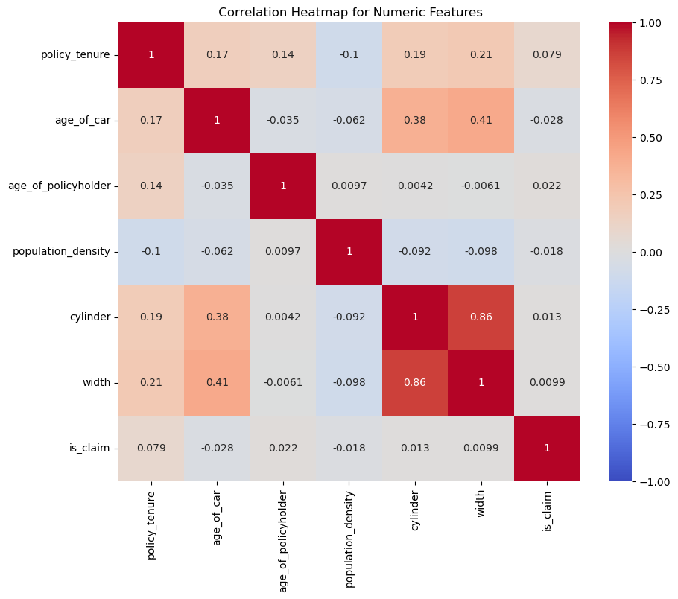

Slide 6
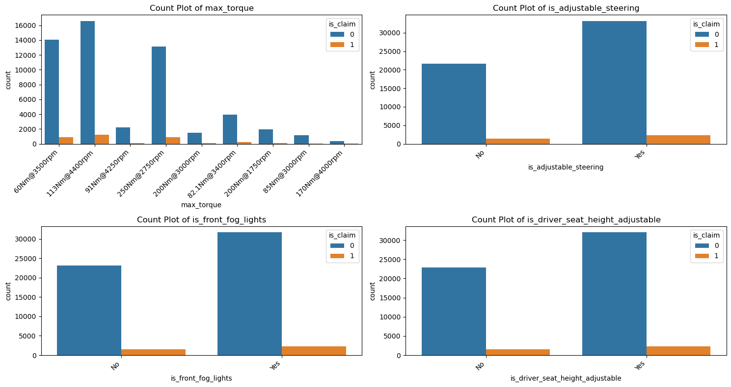

Slide 7
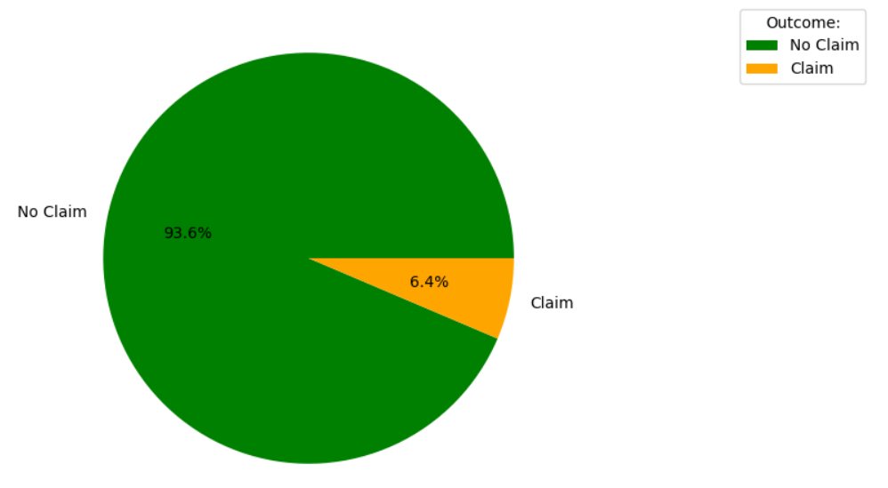
Imbalanced Data
Is_claim:
In the logistic regression model I applied to the imbalanced dataset, the overall accuracy was approximately 93%. But the sensitivity was 0 and specificity was 1, this was because the model prioritized the accuracy of the majority class. The model did great at identifying who wouldn't claim, but completely failed to catch those who would. This is a big issue for since our main goal is to predict who might file a claim.

Slide 8
Data Preparation
I created 2 new datasets, one oversampled and other under sampled.
I used SMOTE for oversampling which boosts the minority class by generating synthetic examples and used RandomUnderSampler for under sampling.
In oversampling, there is risk of overfitting and in under sampling there is chance of information loss, so I decided to create two separate datasets and compare how different models perform on these new datasets.
After balancing the data, I converted the categorical columns into numerical using one hot encoding and split the data into training and testing (80-20 split).
Applied 4 Classification Algorithms :
Logistic Regression
Random Forest
SVM
XGBOOST

Slide 9
Results
Model | Dataset | Accuracy | Sensitivity | Specificity | F1-Score | ROC-AUC
Logistic Regression | Imbalanced | 0.93 | 0.00 | 1.00 | 0.00 | 0.50
Logistic Regression | Oversampled | 0.56 | 0.56 | 0.56 | 0.14 | 0.56
Logistic Regression | Undersampled | 0.55 | 0.58 | 0.56 | 0.14 | 0.57
Random Forest | Imbalanced | 0.93 | 0.00 | 1.00 | 0.00 | 0.50
Random Forest | Oversampled | 0.54 | 0.59 | 0.54 | 0.14 | 0.57
Random Forest | Undersampled | 0.88 | 0.14 | 0.94 | 0.13 | 0.54
SVM | Imbalanced | 0.92 | 0.01 | 0.99 | 0.02 | 0.50
SVM | Oversampled | 0.44 | 0.54 | 0.44 | 0.11 | 0.49
SVM | Undersampled | 0.51 | 0.46 | 0.52 | 0.11 | 0.49
XGBoost | Imbalanced | 0.93 | 0.00 | 1.00 | 0.00 | 0.50
XGBoost | Oversampled | 0.86 | 0.16 | 0.91 | 0.13 | 0.54
XGBoost | Undersampled | 0.55 | 0.69 | 0.54 | 0.17 | 0.61
ROC-AUC values are around 0.5 for most models on the imbalanced dataset, suggesting random performance, there are improvements in the oversampled and under sampled datasets, especially in XGBoost. However, the values are still moderate.
Sensitivity is crucial in this scenario as correctly identifying individuals likely to file a claim is essential.
Highest sensitivity was achieved by XGBOOST model on the under sampled dataset.

Slide 10
Limitations
Assumption of Feature Importance: While feature selection was performed using statistical tests, the assumptions about the importance of certain features might not hold true, and certain features deemed less important in the dataset might play a crucial role in other contexts.
Synthetic Data in Oversampling: While oversampling using techniques like SMOTE helps address class imbalance, the introduction of synthetic examples assumes that the synthetic instances accurately represent the underlying data distribution. The effectiveness of SMOTE is based on this assumption.
Exploration of Ensemble Methods: The project focused on individual models and their performance on the balanced datasets. A more extensive exploration of ensemble methods and their potential synergy could be beneficial.

Slide 11
THANK YOU!!

